Slide 1
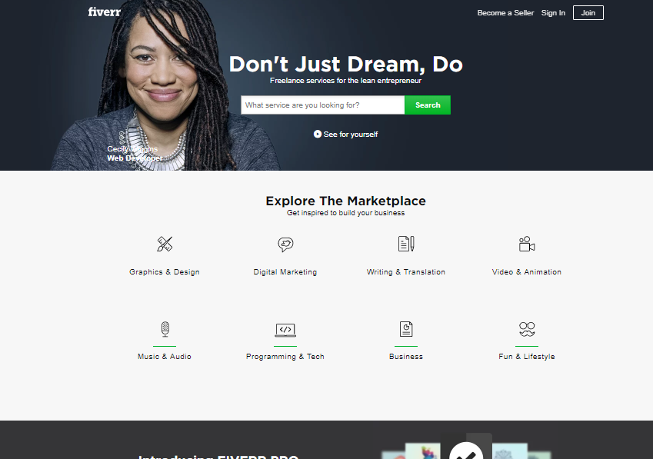

Data Analysis on “fiverr.com”
Kevin Hwang
NYC Data Science Academy
Web Scrapping Project

Slide 2
Company Background
Fiverr is one of the top WorldWide Freelance Service Companies
A marketplace for creative and professional services.
Launched February 2010
Headquarter Washington DC
Services offered writing, translation, graphic design, video editing and programming
Marketplace Categories
Graphics & Design
Digital Marketing
Writing & Translation
Video & Animation
Music & Audio
Programming & Tech
Business
Fun & Lifestyle

Slide 3
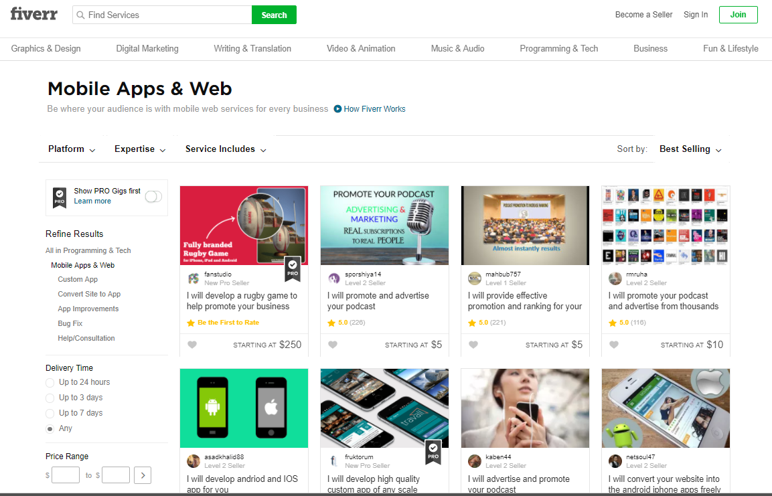
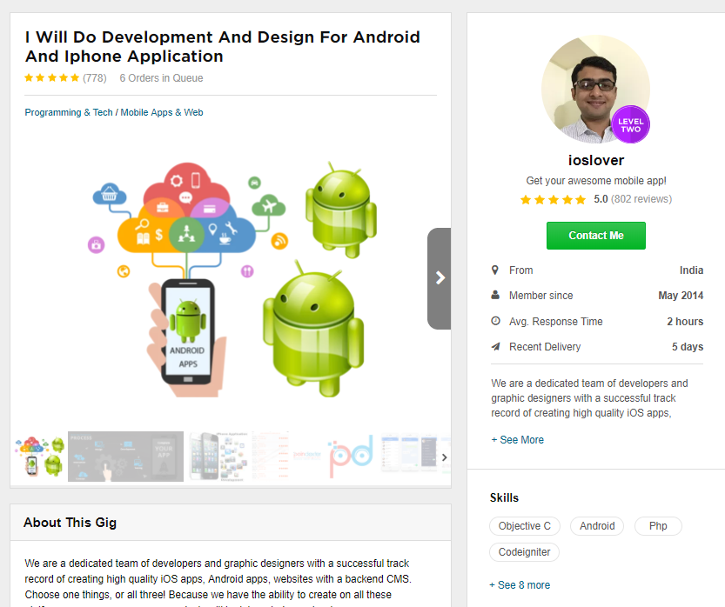
What it looks like

Slide 4
Why ‘fiverr’ for scraping project?
Fiverr not only provides services to help complete one’s project like my scraping project BUT also provides opportunities to startups or individuals to outsource their works and gain experiences. Entrepreneurship!
Goal
Help future entrepreneurs gain ideas of tech trends
Show trends of tech and skills of professionals around the world
Help learners look for the next thing to learn
Observations (of 6180)
Freelancers by country
Freelancers by tech
# of customers reached
Costs affect the rating
Skills they possess

Slide 5
Analysis on Programming & Tech
Sub-categories
Chatbot
Data Analysis
Databases
Desktop App Development
Ecommerce
Mobile App Development
Quality Assurance (QA)
Web Programming
Website Building
WordPress

Slide 6
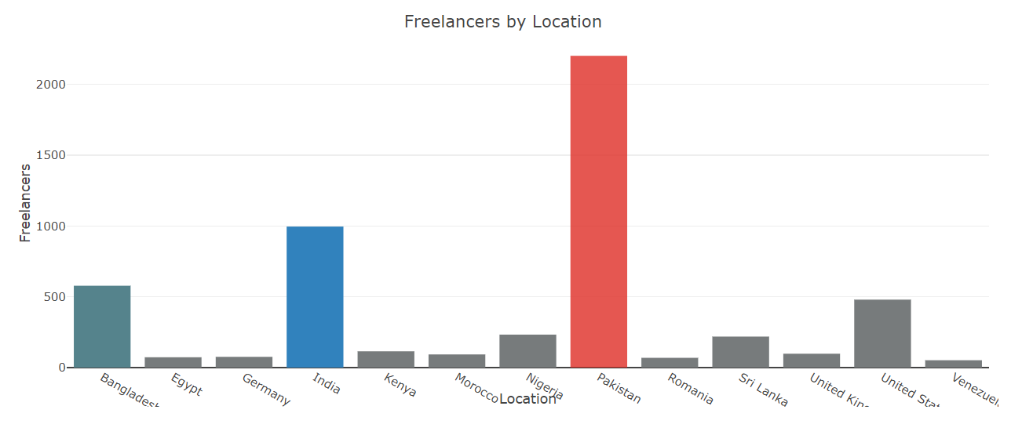
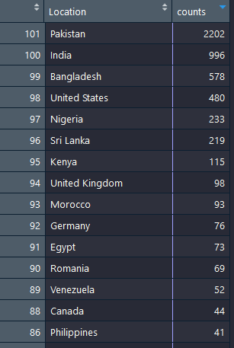
Number of Freelancers by Country
Observed total
6180 Freelancers & Posts
In 101 Countries

Slide 7
Number of Freelancers by Country
Observed total
6180 Freelancers & Posts
In 101 Countries

Slide 8
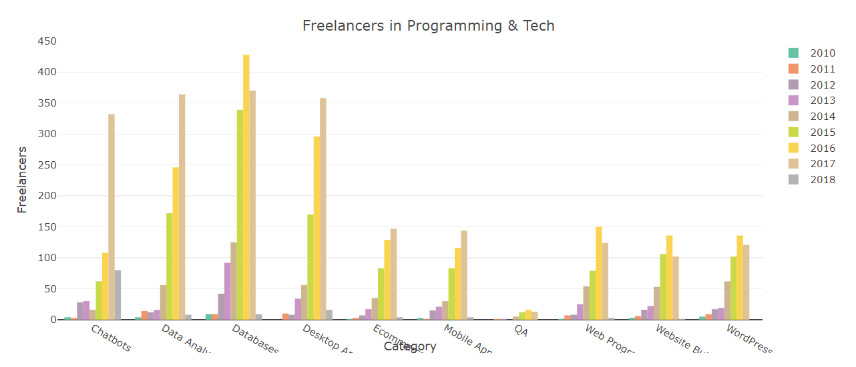
Yearly Growth of Freelancers by Tech
Big jump for Chatbot in 2017 + fast growth this year!

Slide 9
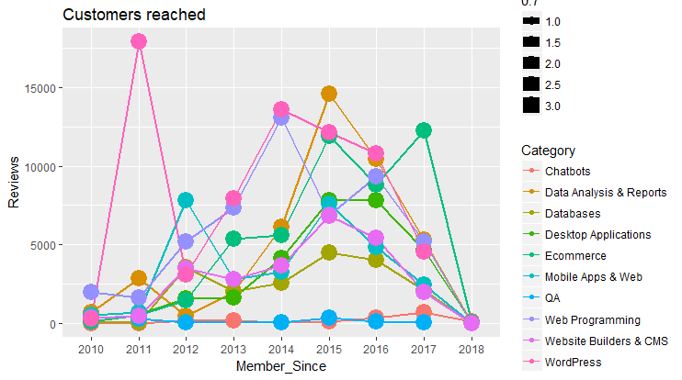
Customers Reached by year
Huge Growth in Ecommerce in 2017

Slide 10
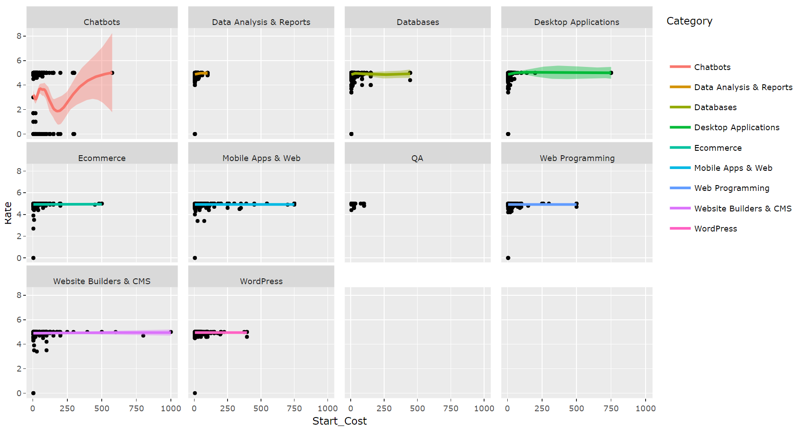
Cost vs Customers rate

Slide 11
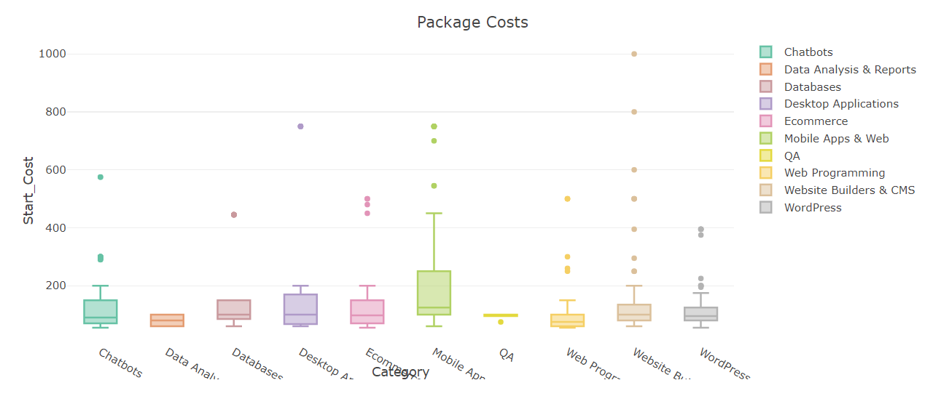
Start Cost Overview
Outlier = high cost projects

Slide 12
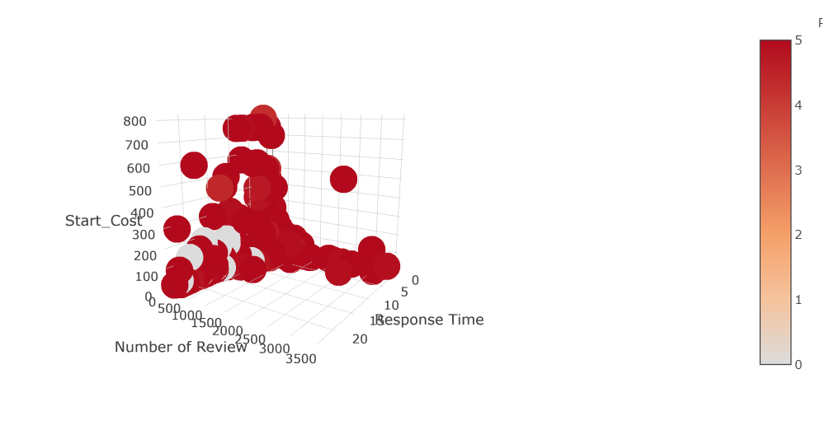
Customers Rate 3D model
Rating =
Cost x Response Time x Number of Customers reached
Rate

Slide 13
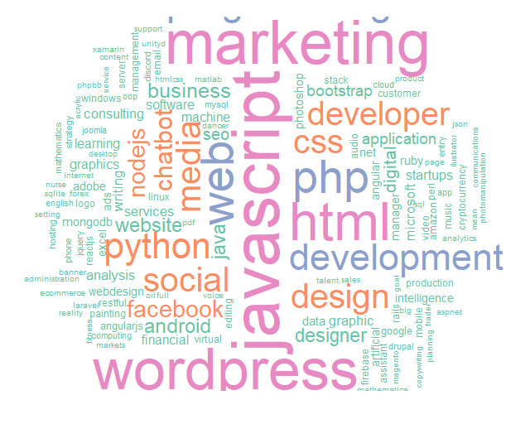
Wordcloud Category: Chatbot

Slide 14
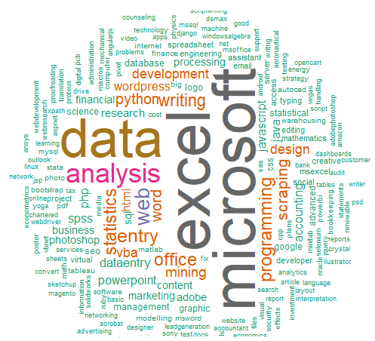
Wordcloud Category: Data Analysis

Slide 15
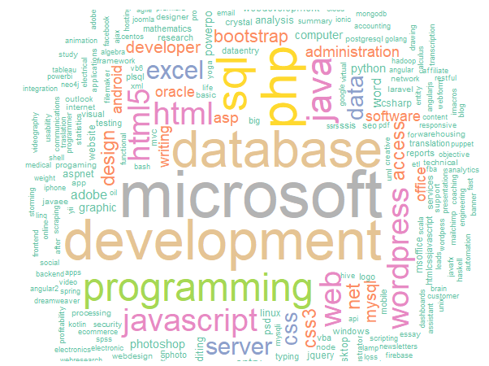
Wordcloud Category: Databases

Slide 16
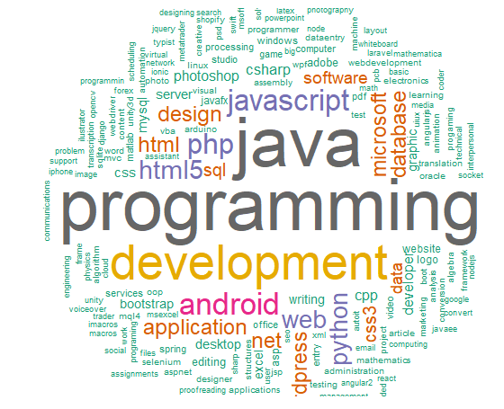
Wordcloud Category: Desktop App

Slide 17
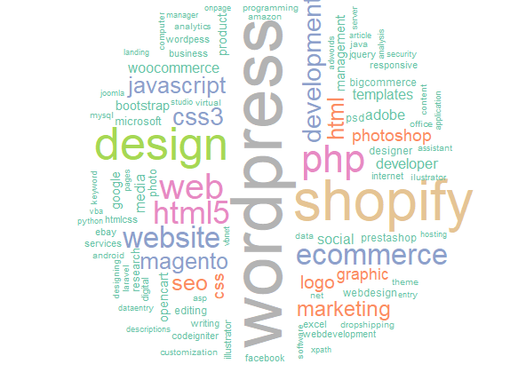
Wordcloud Category: Ecommerce

Slide 18
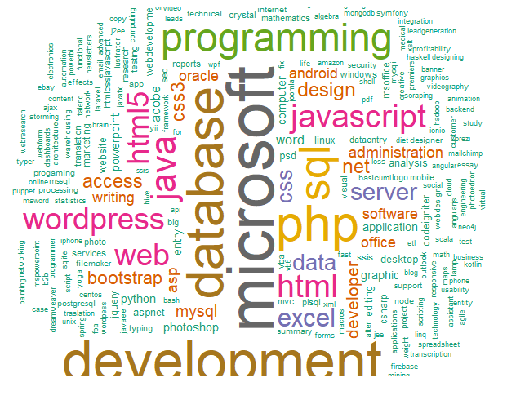
Wordcloud Category: Mobile App Development

Slide 19
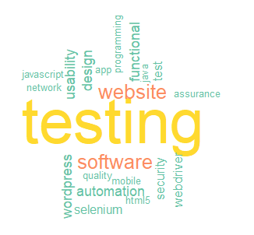
Wordcloud Category: QA

Slide 20
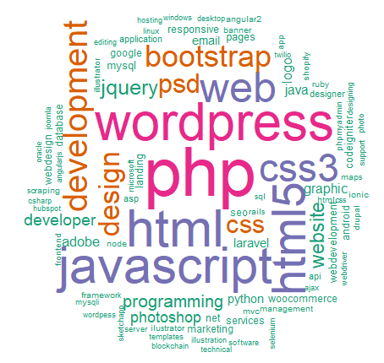
Wordcloud Category: Web Programming

Slide 21
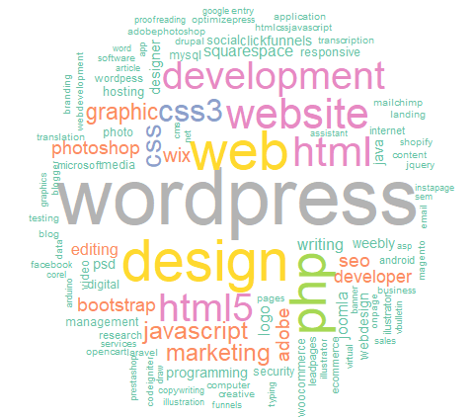
Wordcloud Category: Website Building

Slide 22
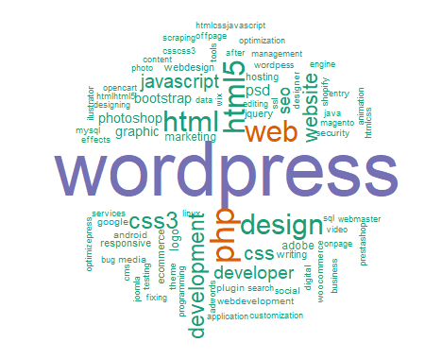
Wordcloud Category: WordPress

Slide 24
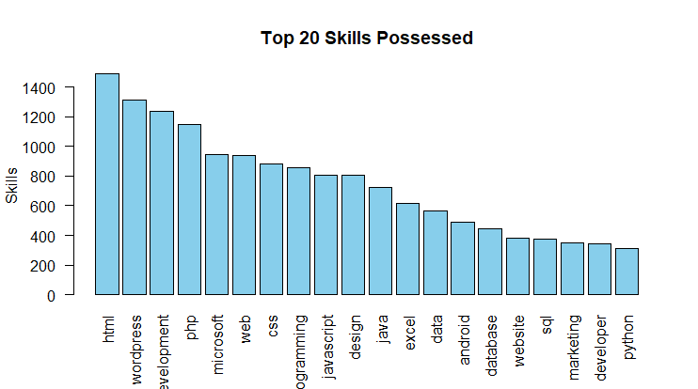
Top 20 Skills they possessed

